Slide 1

Department of Information Technology
NBA Accredited A.P. Shah Institute of Technology G.B.Road,Kasarvadavli, Thane(W), Mumbai-400615 UNIVERSITY OF MUMBAI Academic Year 2020-2021

Slide 2
A Project Report on Home Automation using AI Submitted In Fulfillment of the Degree of Bachelor of Engineering(Sem-8) in INFORMATION TECHNOLOGY By Akhil Jain(18204005)
Saunvid Ganbavale(17104052) Sagar Gabre(18204011) Under the Guidance of Dr. Uttam Kolekar
-Prof. Kiran Deshpande

Slide 3
1. Introduction
Home automation or domotics is building automation for a home, called smart home or smart house.
A home automation system will control lighting, entertainment systems and appliances. It may also include home security such as access control and alarm systems.
When connected with the internet, home devices are an important constituent of the internet of things.

Slide 4
1.1 Abstract
In today’s world Automatic systems are being preferred over manual system.
With advancement of Automation technology, life is getting simpler and easier in all aspects.
With the rapid increase in the number of users of internet over the past decade has made Internet a part and parcel of life, and IoT is the latest and emerging internet technology.
Internet of things is a growing network of everyday object-from industrial machine to consumer goods that can share information and complete tasks while you are busy with other activities.

Slide 5
1.2 Objectives
The objective of this project is to implement a low cost, reliable and scalable home automation system that can be used to remotely switch on or off any household appliance, using a phone to achieve hardware simplicity.

Slide 6
1.3 Literature Review
1. | Title: | Literature Review on Home Automation
 | Author and Publisher: | Manish Prakash Gupta, Neha Shrivastava
 | Description | Home, it is the place where one fancies or desires to be after a long tiring day. People come home exhausted after a long hard working day. Some are way too tired that they find it hard to move once they land on their couch, sofa or bed. So any small device/technology that would help them switch theirs lights on or off, or play their favorite music etc. on a go with their voice with the aid of their smart phones would make their home more comfortable. Moreover, it would be better if everything such as warming bath water and adjusting the room temperature were already done before they reach their home just by giving a voice command.

Slide 7
1.3 Literature Review
2. | Title: | A REVIEW PAPER ON HOME AUTOMATION
 | Author and Publisher: | Nikita Baidya, Prem Kumar S
 | Description | Home automation is become more beneficial because of its safety and security. Nowadays, home automation became more advance and precise to monitor all the home appliances. Home automation system become energy efficient and highly approachable smart home technique. It involves basic features to maintain the user satisfaction and comfort.

Slide 8
1.3 Literature Review
3. | Title: | A Review on Home Automation System (HAS)
 | Author and Publisher: | Renuka P. Dhage, S.P.Kharde
 | Description | Sougata Das, describes the design and development Home Automation System in which a system for household appliance control using cell phone through global system for mobile communication (GSM) technology. This system allows the user or home owner to monitor and control the home appliances via mobile phone set by sending commands in the form of SMS (short message service) messages and the system also provides current status of the home appliances.

Slide 9
1.4 Problem Definition
Conventional wall switches are located in different parts of the house and thus necessitates manual operations like to switch on or off all of theses witches to control various appliances that are running and also monitoring their performances.
Home automation provides security, energy efficiency and ease of use hence, it is adopted more.
It also provides remote interface to home appliances to provide control.

Slide 10
1.5 Scope
Home automation is the wireless and remote control of different aspects of a living space like lighting, temperature, security, entertainment, etc. It performs with the help of connected smart devices and appliances that use communication technology like WiFi, Bluetooth and Ethernet, to share data and facilitate the efficient management of power consumption. It has advantages like:
Cost-effective: Home automation appliances have a longer life cycle than the regular device. Hence this saves money.
Self-sufficient: The home automation technologies come with the option of running on sustainable sources of energy like wind or solar power and even water harvesting.

Slide 11
1.6 Technology stack
1.SOFTWARE REQUIREMENTS
Arduino IDE
Android Studio
Python
2.HARDWARE REQUIREMENTS
ARDUINO UNO
Raspberry PI
RELAYS
FINGERPRINT SCANNER
LED INDICATORS
SOLENOID LOCK

Slide 12
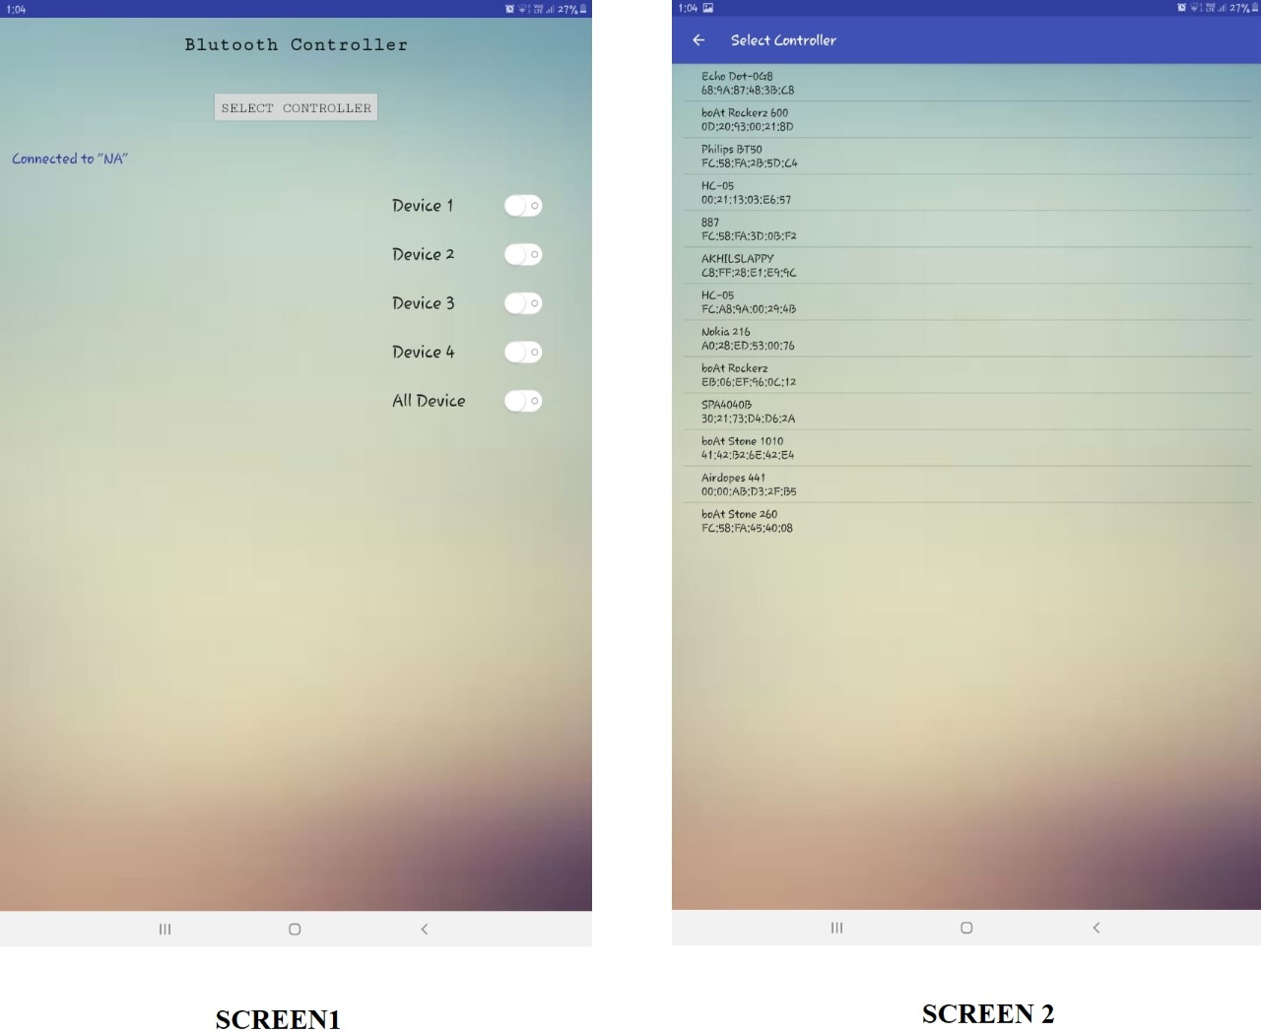
Project Design

Slide 13
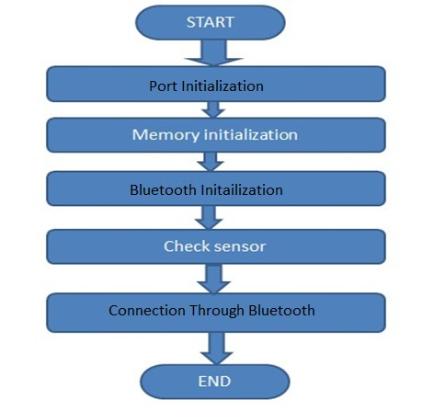
2.1 Proposed System

Slide 14
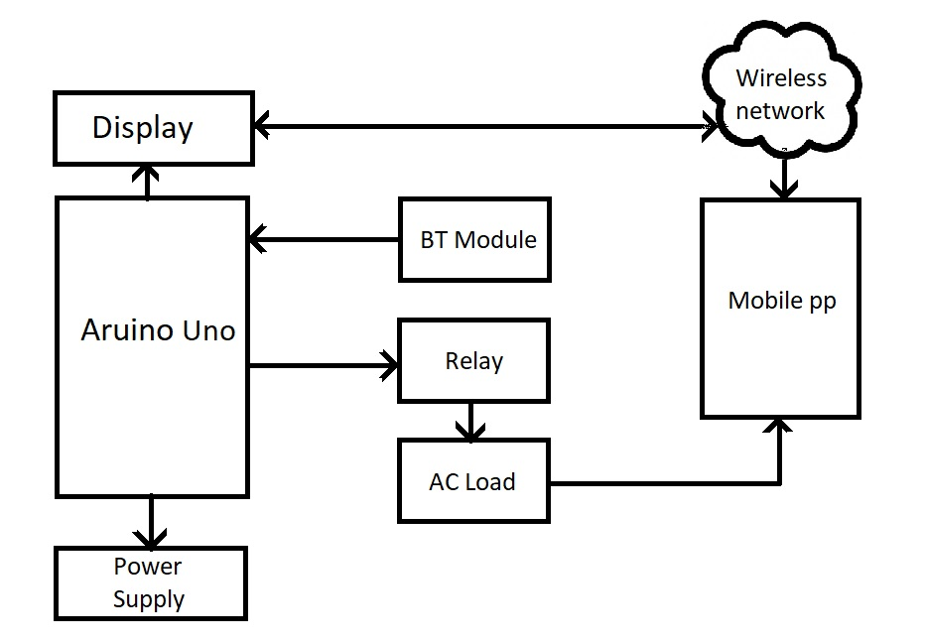
2.2 Prototype Design Demonstration

Slide 15
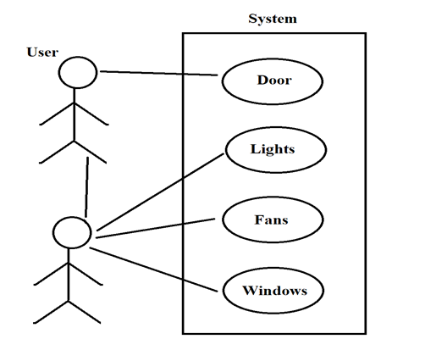
2.3 Description Of Use Case

Slide 16
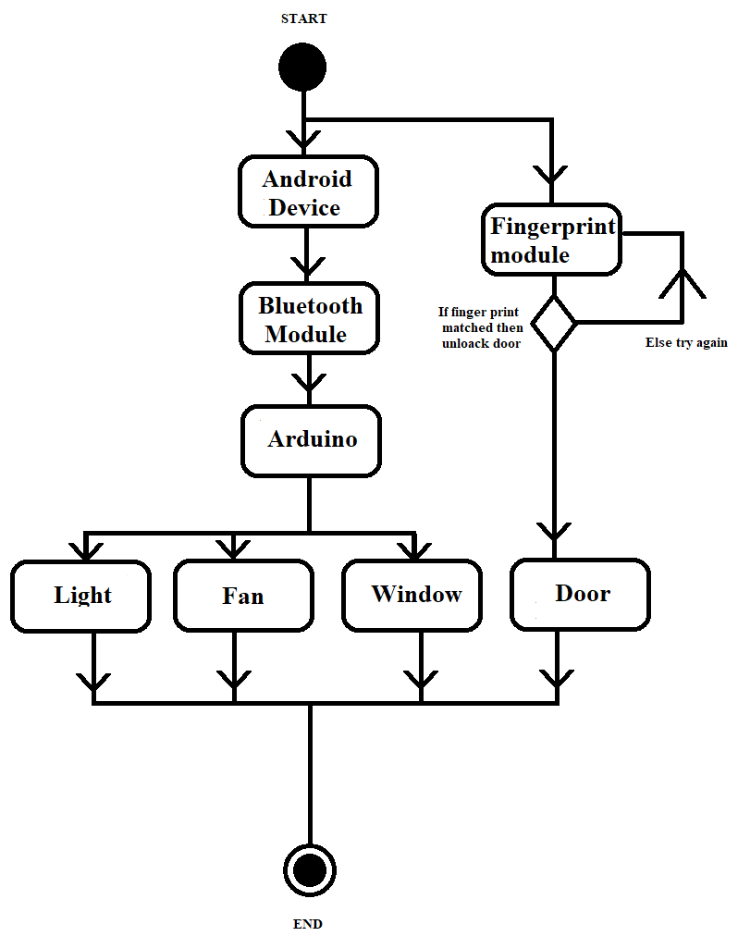
2.4 Activity diagram

Slide 17
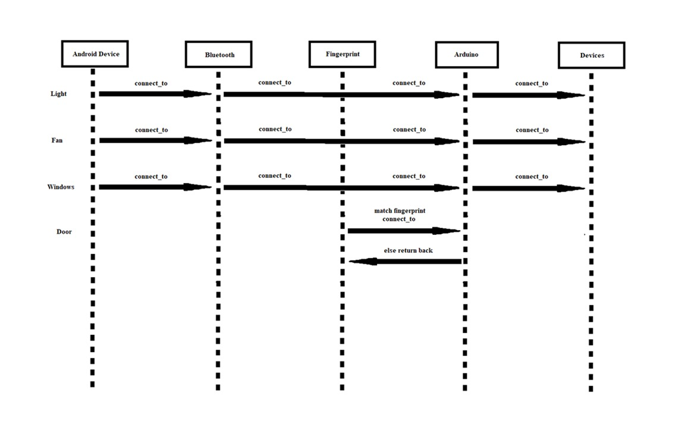
2.5 Sequence Diagram

Slide 18
2.6 Result

Slide 19
2.7 Project Timeline
Planning
1 April – 30 June
Analysis
1 July – 31 August
Design and Requirements
1 September – 30 November
Development & Implementation
1 December – 30 April

Slide 20
2.8 Conclusion
The home automation app using android been experimentally proven to work satisfactory by connecting simple appliances to it and the appliances were successfully controlled remotely through an app.
Home automation is undeniably a resource which can make a home environment automated. People can control their electrical devices via these Home automation devices and set up controlling actions through mobile,electrical devices via these Home automation devices and set up controlling actions through mobile.

Slide 21
References
1. Oudji, S., Courr`eges, S., Paillard, J. N., Magneron, P., Meghdadi, V., Brauers, C., and Kays, R. “Radiofrequency Interconnection between Smart Grid and Smart Meters Using KNX-RF and 2.4 GHz Standard Protocols for Efficient Home Automation Applications”.Journal of Communications, Vol.10, No. 10, (2015).
2. Kumar, M., and Shimi, S. L. “Voice Recognition Based Home Automation System for
Paralyzed People. System”, Vol. 4, No. 10, (2015)
3. A. N. Shewale, J. P. Bari. “Renewable Energy Based Home Automation System Using ZigBee” (2015)

Slide 22
Paper Publication
IEEE paper is ready yet pending to be published which will be done soon.

Slide 23
Thank You

